Slide 1
220301 Meeting
医学学位プログラム2年 202030401 森本 健斗
Notes:
Today, I would like to talk about my progress.

Slide 2
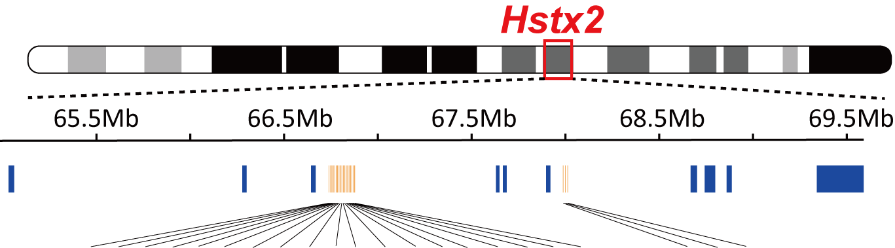
microRNA (miRNA) on Hstx2
 | Gene | testis expression | SNP | KO
Cluster1 (C1-XmiRs) | Mir743 | ○ | ○ | ○
 | Mir743b | ○ | - | -
 | Mir742 | ○ | - | -
 | Mir883a | ○ | - | -
 | Mir883b | ○ | - | -
 | Mir471 | ○ | - | -
 | Mir741 | ○ | - | ○
 | Mir463 | ○ | - | ○
 | Mir880 | ○ | - | ○
 | Mir878 | ○ | - | ○
 | Mir881 | ○ | - | ○
 | Mir871 | ○ | - | ○
 | Mir470 | ○ | - | -
 | Mir465d | ○ | - | ○
 | Mir465c-2 | ○ | ○
 | Mir465b-1 | ○ | -
 | Mir465c-1 | ○ | ○
 | Mir465b-1 | ○ | -
 | Mir465 | ○ | -
Cluster2 | Mir201 | ○ | - | -
 | Mir547 | ○ | - | -
 | Mir509 | ○ | - | -
Chr X
19 miRNA
3 miRNA
Cluster 1
Cluster 2
(C1-XmiRs)
I focus on C1-XmiRs
Morimoto K., et al. Sci. Rep. (2020)
Ota H., et al. PLOS one (2019)
Zhang H., et al. MBE (2019)

Slide 3
Previous result; C1-XmiRs^{fullΔ} mice fertility
C1-XmiRs (19 miRNA)
C1-XmiRs^{fullΔ} mice
63.7 Kb
Table. CRISPR result
Target | inj | transª | newborn^{b} | birthrate^{b/a} | Screening^{c} (weaning) |  |  | posi.
 |  |  |  |  |  |  |  | ♂ |  | ♀ |  | Total^{d} | Mutation efficiency^{(c/d)}
 |  |  |  |  | ♂ | ♀ | total | hemi | mosaic | homo | Hetero /mosaic
C1-XmiRs | 110 | 90 | 17 | 19% | 11 | 6 | 17 | 0 | 1 | 0 | 0 | 1 | 5.9%
Table. Natural mating result
Target | Mating Pattern |  | Number of F1
 |  |  | ♂ |  |  | ♀
 | Founder | Wild-Type | Hemizygote | Wild-Type | Total | Heterozygote | Wild-Type | Total
C1-XmiRs | ♂ | ♀ | 0 | 8 | 8 | 0 | 6 | 6
C1-XmiRs might be essential for spermatogenesis
Notes:
Firstly, to investigate all C1-XmiRs, I generate C1-XmiRs full deletion mice.
To generate C1-miRs full deletion mice, I targeted two sites and aimed to delete all region of C1-XmiRs.
Upper table show CRISPR result.
Unfortunately, I obtained only 1 mosaic male founder.
To investigate fertility, I performed natural mating test, that mated this male founder with wild type B6 females.
However, I could not obtain next generation carrying C1-XmiRs full deletion allele.
This result suggest that c1-xmiRs might be essential for spermatogenesis.

Slide 4
Problems
Which C1-XmiRs
What combination of C1-XmiRs
are essential for spermatogenesis
・
・
How regulates meiosis
Combinations of 19 C1-XmiRs are 524,288 patterns….
New approach
Combined CRISPR-Cas, PiggyBac and Blastocyst complementation
CTRL-Mutagenesis
(CRISPR & Transposase based Regional Mutagenesis)

Slide 5
CTRL-Mutagenesis
CTRL-Mutagenesis
C1-XmiRs region
ESC
Evaluate effect of C1-XmiRs KO
testis

Slide 6
What is PiggyBac transposon system
PiggyBac transposon system
Genomic integration
Transposon excision
PiggyBac Transposase
ITR
ITR
Insert gene
Insert gene
Genome
TTAA
Genome
No footprints

Slide 7

胚盤胞補完法を用いたキメラマウス作製
Nanos3 KO；始原生殖細胞期で生殖細胞が欠失
no
germ cell
Nanos3 KO
zygote
KO mouse
Nanos3 triple CRISPR
Cas9 protein
Germ cells derived from ESCs only
Nanos3 KO
Blastocyst
Target gene of Interest KO
ES cell
testis
zygote
Chimera mouse
Miura K., et al. Biol. Reprod. (2019)
Notes:
Next, blastocyst complementation can generate germ cells mutant chimera mice rapidly.
If injected es cells into germ cell essential gene KO blastocyst, in this chimera mouse, germ cells are derived from es cell only.

Slide 8
CTRL-Mutagenesis
17 C1-XmiR sgRNA
Vector Library
ESC
sgRNA for C1-XmiR
sgRNA for common EGxxFP
Neo^{R}
PiggyBac
sgRNA for C1-XmiR
sgRNA for common EGxxFP
Neo^{R}
1~15 copies integration
ESC
Positive selection by neomycin
Transfection
sgRNA for C1-XmiR
sgRNA for common EGxxFP
Neo^{R}
1~15 copies
ESC
Cas9
HSV-TK
common EGxxFP
HSV-TK
Single cell sorting by EGFP signal (FACS)
Removal vector
ESC
Negative selection by ganciclovir
; The cells carrying HSV-TK die by ganciclovir
sgRNA for C1-XmiR
sgRNA for common EGxxFP
Neo^{R}
1~15 copies
Blastocyst complementation
Target 1
Target 2
C1-XmiR Region
Regional deletion Mutation
and / or
Indel Mutation
8
Various mutant chimera mice
Notes:
I show the scheme of CTRL-mutagenesis.
Firstly, I will prepare pb transposon vector library that carrying sgRNA targeting C1-xmirs and sgRNA targeting common EGxxFP and neomycin resistance gene.
Each 19 transpon vector target each C1-xmiRs.
Secondly, I will transfect these vector library and transposase and hsv-tk expression vector into es cells.
These transfected es cells must carry 1-15 copies of these transposons.
Thirdly, I will perform positive selection by neomycin.
Next, I will transfect Cas9 and hsv-tk expression vector and common EGxxFP and HSV-TK expression vector into these esc.
If transfect Cas12a vector and egxxfp vector, Cas12a cut on C1-xmiRs and EGxxFP and then these ES cells are EGFP positive.
I will perform single cell sorting by egfp signal and incubate for removal vector from es cells.
After that, I will perform negative selection by ganciclovir.
The cells carrying hsv-tk die by ganciclovir.
After these procedures, these es cells must transposon and c1-xmirs mutant allele such as regional deletion mutation and or indel mutation.
Next by blastocyst complementation, I will generate various mutant chimera mice.

Slide 9
CTRL-Mutagenesis
17 C1-XmiR sgRNA
Vector Library
ESC
sgRNA for C1-XmiR
sgRNA for common EGxxFP
Neo^{R}
PiggyBac
sgRNA for C1-XmiR
sgRNA for common EGxxFP
Neo^{R}
1~15 copies integration
ESC
Positive selection by neomycin
Transfection
sgRNA for C1-XmiR
sgRNA for common EGxxFP
Neo^{R}
1~15 copies
ESC
Cas9
HSV-TK
common EGxxFP
HSV-TK
Single cell sorting by EGFP signal (FACS)
Removal vector
ESC
Negative selection by ganciclovir
; The cells carrying HSV-TK die by ganciclovir
sgRNA for C1-XmiR
sgRNA for common EGxxFP
Neo^{R}
1~15 copies
Blastocyst complementation
Target 1
Target 2
C1-XmiR Region
Regional deletion Mutation
and / or
Indel Mutation
9
Various mutant chimera mice
Notes:
I show the scheme of CTRL-mutagenesis.
Firstly, I will prepare pb transposon vector library that carrying sgRNA targeting C1-xmirs and sgRNA targeting common EGxxFP and neomycin resistance gene.
Each 19 transpon vector target each C1-xmiRs.
Secondly, I will transfect these vector library and transposase and hsv-tk expression vector into es cells.
These transfected es cells must carry 1-15 copies of these transposons.
Thirdly, I will perform positive selection by neomycin.
Next, I will transfect Cas9 and hsv-tk expression vector and common EGxxFP and HSV-TK expression vector into these esc.
If transfect Cas12a vector and egxxfp vector, Cas12a cut on C1-xmiRs and EGxxFP and then these ES cells are EGFP positive.
I will perform single cell sorting by egfp signal and incubate for removal vector from es cells.
After that, I will perform negative selection by ganciclovir.
The cells carrying hsv-tk die by ganciclovir.
After these procedures, these es cells must transposon and c1-xmirs mutant allele such as regional deletion mutation and or indel mutation.
Next by blastocyst complementation, I will generate various mutant chimera mice.

Slide 10
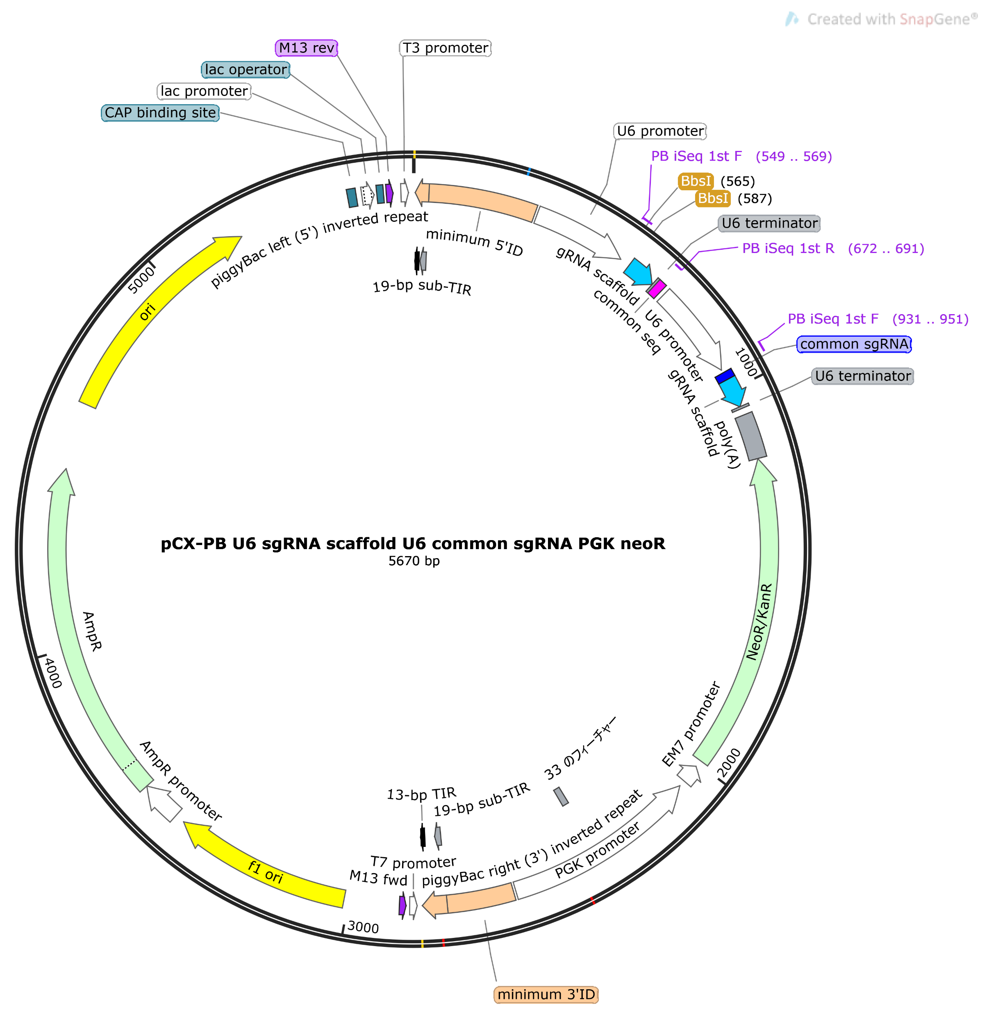
sgRNA for C1-XmiR
sgRNA for common EGxxFP
Neo^{R}

Slide 11
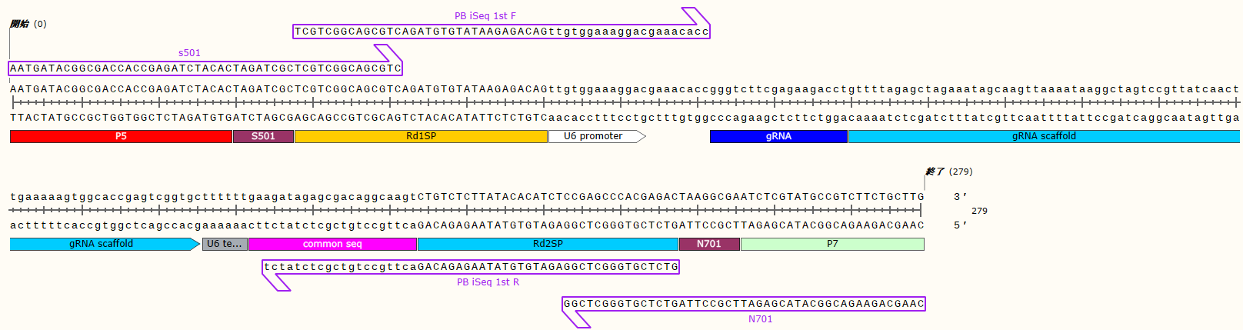
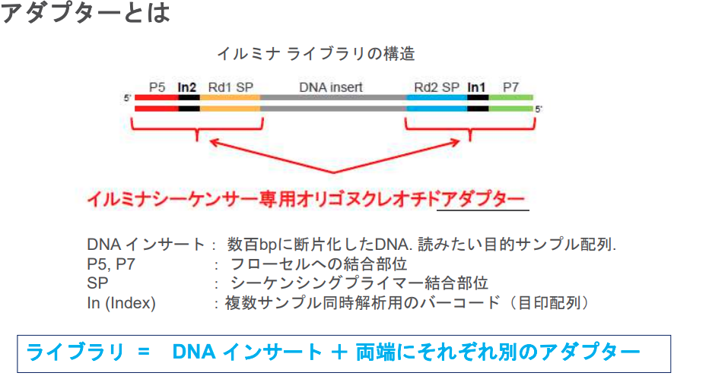

Slide 12
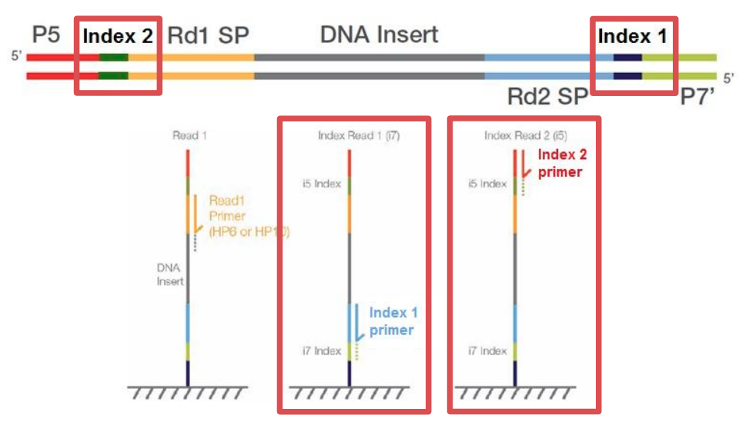

Slide 13
 | bp
total size (C57BL/6J) | 2728230000
vector size | 5670
transposon size | 2807
ratio (1 transposon/Genome+1 transposon) 0.00010%
Genome | 1 transposon | 1 vector | 5 vector
12.5ng | 1.28609E-05 | 2.59784E-05 | 0.000129892
(pg) | 0.012860889 | 0.025978355 | 0.129891774
① | 1 vector (1 copy)
② | Bulk ES genome
③ | 17 vector (1 copy each)
④ | 16 vector (1 copy each) (-Mir881)
⑤ | 17 vector (5 copies each)
⑥ | 16 vector (1 copy each) (-Mir465d)
⑦ | 16 vector (1 copy each) (-Mir465b)
⑧ | 16 vector (1 copy each) (-Mir465c)
Mir743 | ① | Mir471 | ⑥ | Mir871 | ⑪ | Mir465a | ⑯
Mir743b | ② | Mir741 | ⑦ | Mir470 | ⑫ | Mir881-Up | ⑰
Mir742 | ③ | Mir463 | ⑧ | Mir465d | ⑬
Mir883a | ④ | Mir880 | ⑨ | Mir465c | ⑭
Mir883b | ⑤ | Mir878 | ⑩ | Mir465b | ⑮

Slide 14
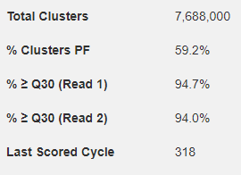
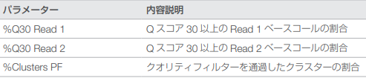
iSeq 結果
 | [H/N]701 | [H/N]702 | [H/N]703 | [H/N]704 | [H/N]705 | [H/N]706
[E/H/N/S]502 | 1-1 | 1-2 | 1-3 | 1-4 | 1-5 | 1-6
[E/H/N/S]503 | 1-7 | 1-8 | 1-9 | 1-10 | 1-11 | 1-12
[E/H/N/S]504 | 1-13 | 1-14 | 1-15 | 1-16 | 1-17 | 2
[E/H/N/S]517 | 3 | 4 | 5 | 6 | 7 | 8
1-1 FASTQファイル
@FS10002129:1:BPN80007-2609:1:1101:1280:1000 1:N:0:1
TTGTGGAAAGGACGAAACACCACACCAAGCTGAGTATAGTAGTTTTAGAGCTAGAAATAGCAAGTTAAAATAAGGCTAGTCCGTTATCAACTTGAAAAAGTGGCACCGAGTCGGTGCTTTTTTGAAGATAGAGCGACAGGCAAGTCTGTCT
+
FF:F:FFFFFFFFFFFFFFFFFFFFFFFFFFFFFFFFFFFFFFFFFFFFFFFFFFFFFFFFFFFFFFFFFFFFFFFFFFFFFFFFFFFFFFFFFFFFFFFFFFFFFFFFFFFFFFFFFFFFFFFFFFFFFFFFFFFFFFFFFFFFFFFFFF
@FS10002129:1:BPN80007-2609:1:1101:2480:1000 1:N:0:1
TTGTGGAAAGGCGAAACACCACACCAAGCTGAGTAGAGTAGTTTTAGAGCTAGAAATAGCAAGTTAAAATAAGGCTAGTCCGTTATCAACTTGAAAAAGTGGCACCGAGTCGGTGCTTTTTTGAAGATAGAGCGACAGGCAAGTCTGTCTT
+
FFFFFFFFFFFFFFFFFFFFFFFFFFFFFFFFFFFFFFFFFFFFFFFFFFFFFFFFFFFFFFFFFFFFFFFFFFFFFFFFFFFFFFFFFFFFFFFFFFFFFFFFFFFFFFFFFFFFFFFFFFFFFFFFFFFFFFFFFFFFFFFFFFFFFF,
@FS10002129:1:BPN80007-2609:1:1101:2560:1000 1:N:0:1
TTGTGGAAAGGACGAAACACCACACCAAGCTGAGTAGAGTAGTTTTAGAGCTAGAAATAGCAAGTTAAAATAAGGCTAGTCCGTTATCAACTTGAAAAAGTGGCACCGAGTCGGTGCTTTTTTGAAGATAGAGCGACAGGCAAGTCTGTCT
+
FFFFFFFFFFFFFFFFFFFFFFFFFFFFFFFFFFFFFFFFFFFFFFFFFFFFFFFFFFFFFFFFFFFFFFFFFFFFFFFFFFFFFFFFFFFFFFFFFFFFFFFFFFFFFFFFFFFFFFFFFFFFFFFFFFFFFFFFFFFFFFFFFFFFFFF
@FS10002129:1:BPN80007-2609:1:1101:2930:1000 1:N:0:1
TTGTGGAAAGGACGAAACACCACACCAAGCTGAGTAGAGTAGTTTTAGAGCTAGAAATAGCAAGTTAAAATAAGGCTAGTCCGTTATCAACTTGAAAAAGTGGCACCGAGTCGGTGCTTTTTTGAAGATAGAGCGACAGGCAAGTCTGTCT
+
FFFFFFFFFFFFFFFFFFFFFFFFFFFFFFFFFFFFFFFFFFFFFFFFFFFFFFFFFFFFFFFFFFFFFFFFFFFFFFFFFFFFFFFFFFFFFFFFFFFFFFFFFFFFFFFFFFFFFFFFFFFFFFFFFFFFFFFFFFFFFFFFFFFFFFF

